Slide 1
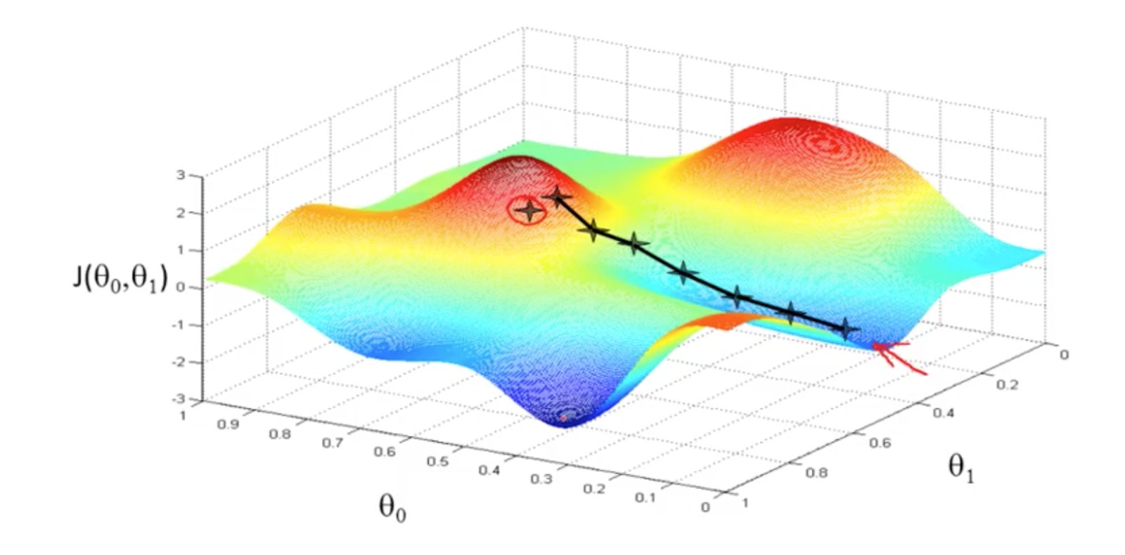
Parameter and Structural learning for HMMS
Data Mining Qualification Presentation
Dr. Li Xiong
Mani Sotoodeh, Spring 2019

Slide 2
Hidden Markov Model
Q: set of states
(hidden!)
π : initial probability distribution
A: transition probability distribution
O : set of possible observations
b_{i}(o_{t}) : probability of s_{i} emitting o_{t}

Slide 3
Hidden Markov models.
Set of states:
Process moves from one state to another generating a sequence of states :
Markov chain property: probability of each subsequent state depends only on what was the previous state:
States are not visible, but each state randomly generates one of M observations (or visible states)
To define hidden Markov model, the following probabilities have to be specified: matrix of transition probabilities A=(a_{ij}), a_{ij}= P(s_{i} | s_{j}) , matrix of observation probabilities B=(b_{i} (v_{m} )), b_{i}(v_{m} ) = P(v_{m} | s_{i}) and a vector of initial probabilities π=(π_{i}), π_{i} = P(s_{i}) . Model is represented by M=(A, B, π).
Notes:
V is o observation

Slide 4
Example of Hidden Markov Model
0.3
0.7
Low
High
0.2
0.8
0.6
0.6
0.4
0.4
Rain
Dry

Slide 5
Main issues using HMMs :
Evaluation problem. Given the HMM M=(A, B, π) and the observation sequence O=o₁ o₂ ... o_{K} , calculate the probability that model M has generated sequence O .
Decoding problem. Given the HMM M=(A, B, π) and the observation sequence O=o₁ o₂ ... o_{K} , calculate the most likely sequence of hidden states s_{i} that produced this observation sequence O.
Learning problem. Given some training observation sequences O=o₁ o₂ ... o_{K} and general structure of HMM (numbers of hidden and visible states), determine HMM parameters M=(A, B, π) that best fit training data.
O=o₁...o_{K} denotes a sequence of observations o_{k}∈{v₁,…,v_{M}}.

Slide 6
Evaluation Problem.
Evaluation problem. Given the HMM M=(A, B, π) and the observation sequence O=o₁ o₂ ... o_{K} , calculate the probability that model M has generated sequence O .
Trying to find probability of observations O=o₁ o₂ ... o_{K} by means of considering all hidden state sequences (as was done in example) is impractical:
N^{K} hidden state sequences - exponential complexity.
Use Forward-Backward HMM algorithms for efficient calculations.
Define the forward variable α_{k}(i) as the joint probability of the partial observation sequence o₁ o₂ ... o_{k} and that the hidden state at time k is s_{i} : α_{k}(i)= P(o₁ o₂ ... o_{k ,} q_{k}= s_{i} )

Slide 7
Forward recursion for HMM
Initialization:
α₁(i)= P(o_{1 ,} q₁= s_{i} ) = π_{i} b_{i} (o₁) , 1<=i<=N.
Forward recursion:
α_{k+1}(i)= P(o₁ o₂ ... o_{k+1 ,} q_{k+1}= s_{j} ) =
Σ_{i} P(o₁ o₂ ... o_{k+1 ,} q_{k}= s_{j ,} q_{k+1}= s_{i} ) =
Σ_{i} P(o₁ o₂ ... o_{k ,} q_{k}= s_{j}) a_{ji} b_{j} (o_{k+1} ) =
[Σ_{j} α_{k}(j) a_{ji} ] b_{i} (o_{k+1} ) , 1<=j<=N, 1<=k<=K-1.
Termination:
P(o₁ o₂ ... o_{K}) = Σ_{i} P(o₁ o₂ ... o_{K ,} q_{K}= s_{i}) = Σ_{i} α_{K}(i)
Complexity :
N²K operations.
α_{k}(i)= P(o₁ o₂ ... o_{k ,} q_{k}= s_{i} )
Notes:
State \ observation till now
Subscript is time
Parantheses is state
''' Input: Transition matrix, pie, state_observation probs, observations
Output: alphas Probabilites of being in different states at each time point for each sample given the observations till that point, i.e filteing
also most likely sequence of staets and its associated probabilies
Used the equations in Machine learning a probabilistic appraoch, Kevin Murphy
'''

Slide 8
Backward recursion for HMM
Define the forward variable β_{k}(i) as the joint probability of the partial observation sequence o_{k+1} o_{k+2} ... o_{K} given that the hidden state at time k is s_{i} : β_{k}(i)= P(o_{k+1} o_{k+2} ... o_{K} |q_{k}= s_{i} )
Initialization:
β_{K}(i)= 1 , 1<=i<=N.
Backward recursion:
β_{k}(j)= P(o_{k+1} o_{k+2} ... o_{K} | q_{k}= s_{j} ) =
Σ_{i} P(o_{k+1} o_{k+2} ... o_{K ,} q_{k+1}= s_{i} | q_{k}= s_{j} ) =
Σ_{i} P(o_{k+2} o_{k+3} ... o_{K} | q_{k+1}= s_{i}) a_{ji} b_{i} (o_{k+1} ) =
Σ_{i} β_{k+1}(i) a_{ji} b_{j} (o_{k+1} ) , 1<=j<=N, 1<=k<=K-1.
Termination:
P(o₁ o₂ ... o_{K}) = Σ_{i} P(o₁ o₂ ... o_{K ,} q₁= s_{i}) =
Σ_{i} P(o₁ o₂ ... o_{K} |q₁= s_{i}) P(q₁= s_{i}) = Σ_{i} β₁(i) b_{i} (o₁) π_{i}
Notes:
Observation from now on| given state
''' Input : Transition matrix, pie, state_observation probs, observations
Output: betas, Probablities of observing the rest of the observations from that point on, given that we are at a given state at a give timepoint for each sample'''

Slide 9
Decoding problem
Decoding problem. Given the HMM M=(A, B, π) and the observation sequence O=o₁ o₂ ... o_{K} , calculate the most likely sequence of hidden states s_{i} that produced this observation sequence.
We want to find the state sequence Q= q₁…q_{K} which maximizes P(Q | o₁ o₂ ... o_{K} ) , or equivalently P(Q , o₁ o₂ ... o_{K} ) .
Brute force consideration of all paths takes exponential time. Use efficient Viterbi algorithm instead.
Define variable δ_{k}(i) as the maximum probability of producing observation sequence o₁ o₂ ... o_{k} when moving along any hidden state sequence q₁… q_{k-1} and getting into q_{k}= s_{i} .
δ_{k}(i) = max P(q₁… q_{k-1} , q_{k}= s_{i} , o₁ o₂ ... o_{k})
where max is taken over all possible paths q₁… q_{k-1} .

Slide 10
Viterbi algorithm
Initialization:
δ₁(i) = max P(q₁= s_{i} , o₁) = π_{i} b_{i} (o₁) , 1<=i<=N.
Forward recursion:
δ_{k}(j) = max P(q₁… q_{k-1} , q_{k}= s_{j} , o₁ o₂ ... o_{k}) =
max_{i} [ a_{ij} b_{j} (o_{k} ) max P(q₁… q_{k-1}= s_{i} , o₁ o₂ ... o_{k-1}) ] =
max_{i} [ a_{ij} b_{j} (o_{k} ) δ_{k-1}(i) ] , 1<=i<=N, 2<=k<=K.
Termination: choose best path ending at time K
max_{i} [ δ_{K}(i) ]
Backtrack best path.
This algorithm is similar to the forward recursion of evaluation problem, with Σ replaced by max and additional backtracking.
Notes:
''' Input : Transition matrix, pie, state_observation probs, observations
Output : The most likely sequence of states (and also the probabilite for each time point) and its probabilite for the given observations
Unlike forward backward, considers the most probable sequence given the state for all time points
not just the optimum state individually for each time point'''

Slide 11
Learning problem (1)
Learning problem. Given some training observation sequences O=o₁ o₂ ... o_{K} and general structure of HMM (numbers of hidden and visible states), determine HMM parameters M=(A, B, π) that best fit training data, that is maximizes P(O | M) .
There is no algorithm producing optimal parameter values.
Use iterative expectation-maximization algorithm to find local maximum of P(O | M) - Baum-Welch algorithm.

Slide 12
Baum-Welch algorithm
General idea:
Expected number of transitions from state s_{j} to state s_{i}
Expected number of transitions out of state s_{j}
a_{ij}= P(s_{i} | s_{j}) =
Expected number of times observation v_{m} occurs in state s_{i}
Expected number of times in state s_{i}
b_{i}(v_{m} ) = P(v_{m} | s_{i})=
π_{i} = P(s_{i}) = Expected frequency in state s_{i} at time k=1.
Notes:
''' Uses an EM moedel and maximul likelihood estimation to learn the parameteres of an HMM model given the observations
In order to compute log likelihood, probabilitey of seeing the observations given the model at that iteration is used.
For convergence purposes, the updating continues till the maximum value of difference between
previous iteration likelihood and current iteartion likelihood among all samples is smaller than machine epsilon.
Inputs : observations,numstates,numobscases
Output: Learned parameteters, pie,transmtrx,obsmtrx
** Note: exmodel is only used for initializations close to reality.

Slide 13
Baum-Welch algorithm: expectation step(1)
Define variable ξ_{k}(i,j) as the probability of being in state s_{i} at time k and in state s_{j} at time k+1, given the observation sequence o₁ o₂ ... o_{K} .
ξ_{k}(i,j)= P(q_{k}= s_{i} , q_{k+1}= s_{j} | o₁ o₂ ... o_{K})
P(q_{k}= s_{i} , q_{k+1}= s_{j} , o₁ o₂ ... o_{k})
P(o₁ o₂ ... o_{k})
ξ_{k}(i,j)=
=
P(q_{k}= s_{i} , o₁ o₂ ... o_{k}) a_{ij} b_{j} (o_{k+1} ) P(o_{k+2} ... o_{K} | q_{k+1}= s_{j} )
P(o₁ o₂ ... o_{k})
=
α_{k}(i) a_{ij} b_{j} (o_{k+1} ) β_{k+1}(j)
Σ_{i} Σ_{j} α_{k}(i) a_{ij} b_{j} (o_{k+1} ) β_{k+1}(j)

Slide 14
Baum-Welch algorithm: expectation step(2)
Define variable γ_{k}(i) as the probability of being in state s_{i} at time k, given the observation sequence o₁ o₂ ... o_{K} .
γ_{k}(i)= P(q_{k}= s_{i} | o₁ o₂ ... o_{K})
P(q_{k}= s_{i} , o₁ o₂ ... o_{k})
P(o₁ o₂ ... o_{k})
α_{k}(i) β_{k}(i)
Σ_{i} α_{k}(i) β_{k}(i)
γ_{k}(i)=
=

Slide 15
Baum-Welch algorithm: expectation step(3)
We calculated ξ_{k}(i,j) = P(q_{k}= s_{i} , q_{k+1}= s_{j} | o₁ o₂ ... o_{K})
and γ_{k}(i)= P(q_{k}= s_{i} | o₁ o₂ ... o_{K})
Expected number of transitions from state s_{i} to state s_{j} =
= Σ_{k} ξ_{k}(i,j)
Expected number of transitions out of state s_{i} = Σ_{k} γ_{k}(i)
Expected number of times observation v_{m} occurs in state s_{i} =
= Σ_{k} γ_{k}(i) , k is such that o_{k}= v_{m}
Expected frequency in state s_{i} at time k=1 : γ₁(i) .

Slide 16
Baum-Welch algorithm: maximization step
Σ_{k} ξ_{k}(i,j)
Σ_{k} γ_{k}(i)
a_{ij} =
Expected number of transitions from state s_{j} to state s_{i}
Expected number of transitions out of state s_{j}
=
Σ_{k} ξ_{k}(i,j)
Σk,o_{k}= v_{m} γ_{k}(i)
b_{i}(v_{m} ) =
Expected number of times observation v_{m} occurs in state s_{i}
Expected number of times in state s_{i}
=
π_{i} = (Expected frequency in state s_{i} at time k=1) = γ₁(i).

Slide 17

Improving Length of Stay Prediction Using a Hidden Markov Model
Source

Slide 18

Importance of Length of Stay Prediction
Intervention to prevent adverse outcomes
Optimization of resource allocation and staff
Improving patients' satisfaction and hospitals’ reputation
Source
Class | < 48 Hours | 2-5 days | > 5 days
Accuracy | 53.1 % | 59.8 % | 31.1 %
Nassar Jr AP, Caruso P. ICU physicians are unable to accurately predict length of stay at admission: a prospective study. International Journal for Quality in Health Care. 2015;28(1):99–103.
Notes:
First talk about the task being difficult and Physician correctly predict short or long staying patients only 50% of time
(Equipment and Beds)
Allocation of staff and care to high risk patients

Slide 19
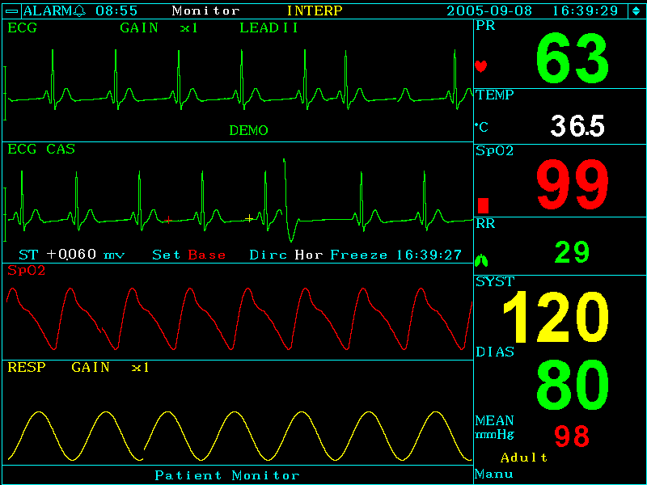
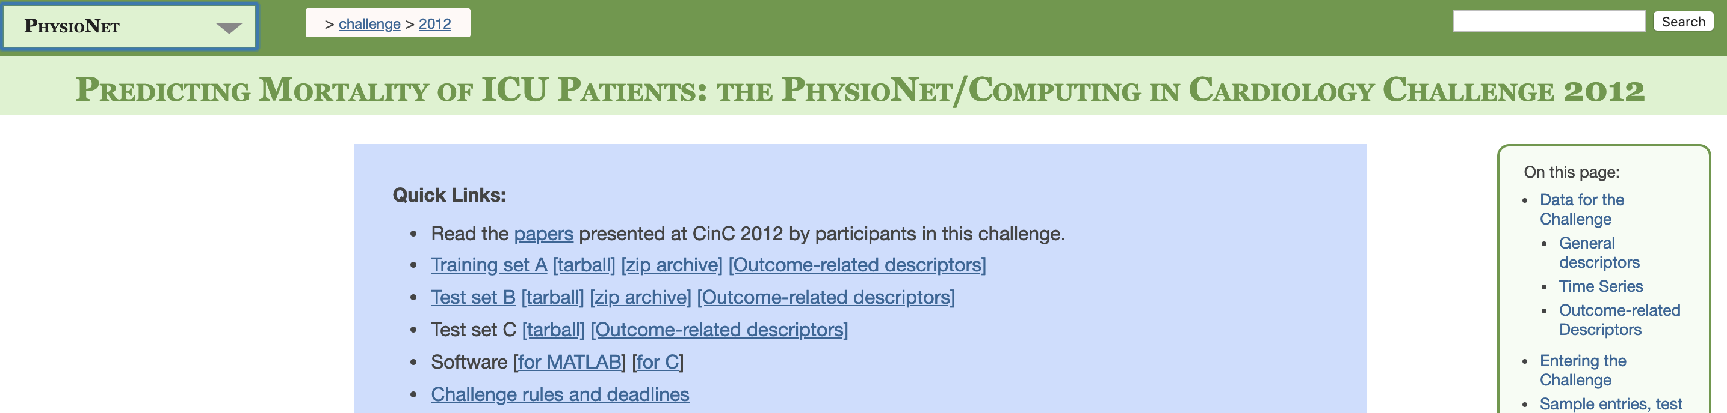
Dataset : Physionet2012 Challenge
Public, Reproducible
4000 patients
37 physiological measurements
48 hours after ICU admission
Source
Link to dataset
Notes:
Higher availability for comparison
, i.e. a single hospital
Also some demographics (i.e. age, gender)
Sufficient size for learning, realistic for practical purpose

Slide 20
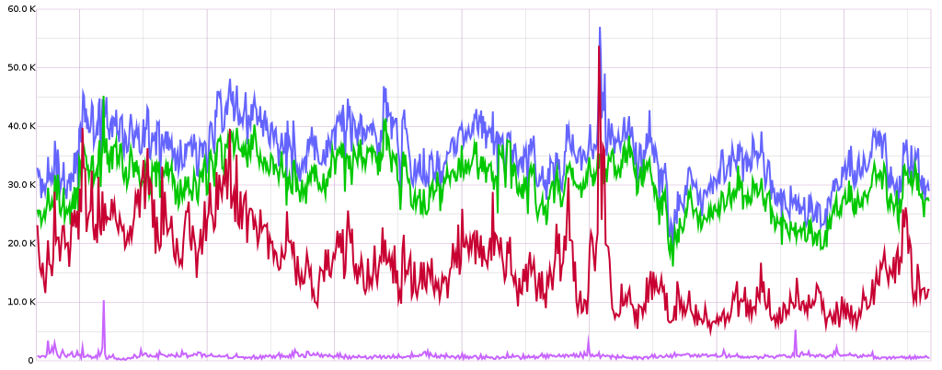
Regression Problem Setup
Selected patient’s time series data for first 48 hours
Feature | Missing % | Avg update frequency (hours)
Heart Rate | 1.6 | 1.05
Temperature | 1.6 | 3.7
Glasgow Coma Scale | 1.6 | 17.33
White Blood Cell Count | 1.8 | 17.057
Serum Glucose | 2.8 | 4.03
Urine Output | 2.9 | 1.89
NIDiasABP | 12.7 | 1.87
Source
12
24
36
48
Time(hours)
Prediction Model
Patient’s Length of Stay(days)
Notes:
Regression → more precise
Lasso,ridge, negative binomial, poisson and Support vector machine Regressions
Impute results in bias, where more data is available through data, better signal for patient states, good proxies
Input : Physiological Measurements throughout time for 48 hours
Output : Length of stay in ICU in days

Slide 21
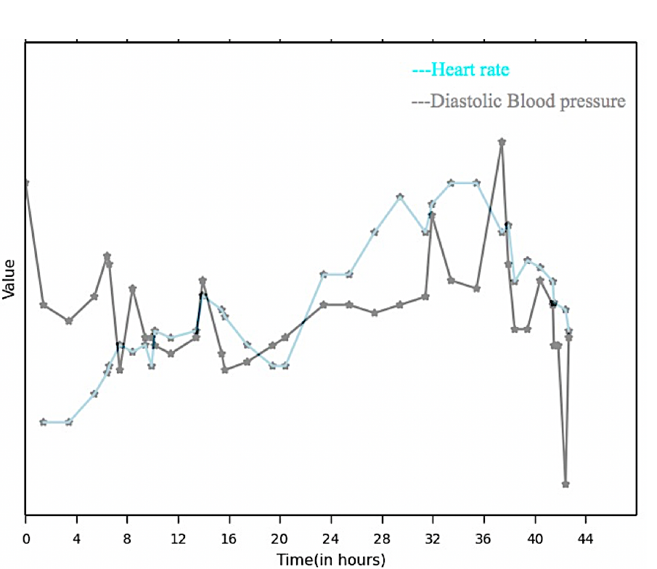
Baseline Models (5 regression models)
Flattened Features :
Annotated example for a given patient and 2 physiological measurement
Heart Rate
Minimum
Blood Pressure
Maximum
BP Maximum
BP Earliest
HR Maximum
Average
Value
HR Average
Earliest
HR Last
BP Last
Last
BP Average
HR Minimum
HR Earliest
BP Minimum
Time (in hours)
Notes:
Utilization of more temporal information in HMM
Meanwhile HMM Model attempts to utilize all temporal information by considering all values
Less parameters to learn, less complexity, explainability transiton and pie and emission probabilities
Five common regression models: LASSO regression
Ridge regression
Poisson regression
Binomial regression
Support vector regression (SVR)
(5 statistics) for each of the 7 variables
35 features in total for each patient

Slide 22
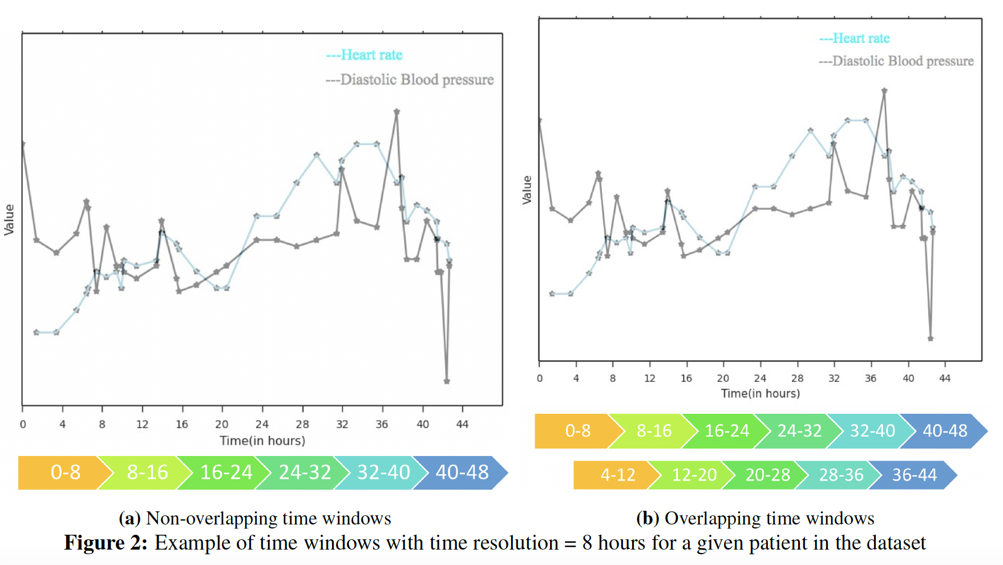
Motivation for our model
Dynamics of Physiological Signals
Interpretability
Heart Rate
Blood Pressure
Value
overlooked
Hidden states
Robust Learning
Observations
Time (in hours)
Notes:
Paramtetr interpretablility
Providing more data to model
Capturing more dynamics
Reds capturing both local minimum points in the same interval while they have significant difference in time, five critical points in the same interval
The puruple ones can better capture what happened before and after these points, capturing more trends, dividing critical points throughout intervals
Transitions

Slide 23
HMM Model Big Picture
Parameters: # of states = 5 Time resolution = 8 # of sequence = 6
Physiological Measures
Aggregating temporally
Observations for a multi-feature Gaussian model
t HR BP Glucose .... Temp
0.5 98 9 80 37
2.1 60 8 95. 32
. . . . .... 40
48 75 7 78. 43
HR BP ... Temp
Window1 82.4 8.4 ... 35.4
Window2 88.3 7.9 ... 38.6
. . . ... .
window6 105.7 6.5 ... 39.5
HMM Model
5 5 4 2 3 3
First state probs:
[ 0.1 0.2 0 0 0.7
Last state probs:
0 0.1 0.8 0.1 0]
Average, median or last time point value
First and last worked best
Lasso Regression Model
Sequence of States
LOS is 5 days
A row of feature matrix
Notes:
Len(Sequence) = # time windows
Spits out likelihood of each state for a given time window

Slide 24
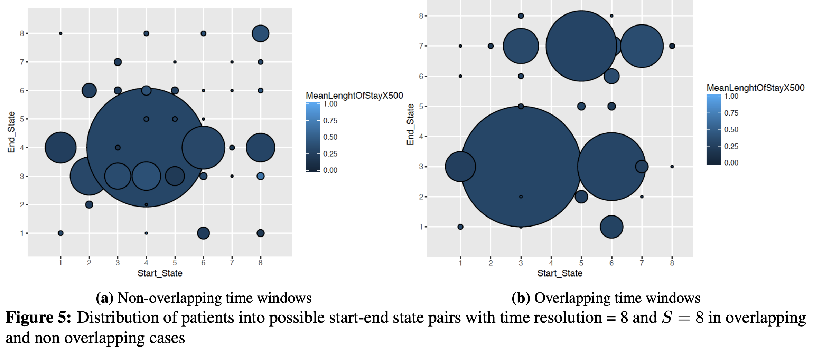
Non/Overlapping time windows
Non overlapping time windows
Overlapping time windows*
Distribution and length of stay of patients across different start end pairs
Crowded pair(4 vs 6)
Single patient pairs (28 vs 14)
Notes:
Well distributed
We also considered certainty for that look in the paper

Slide 25
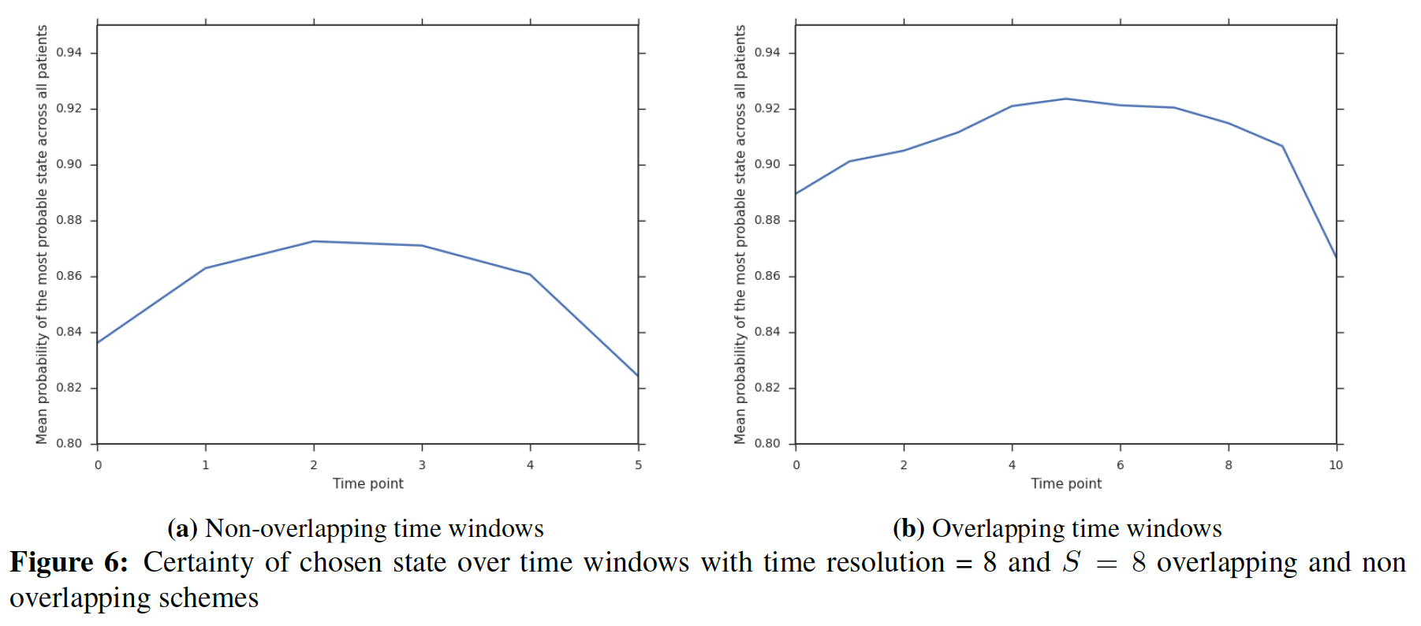
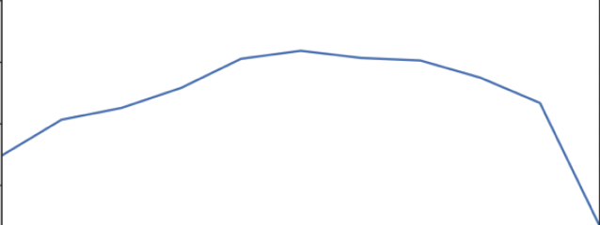
Certainty
Overlapping time windows
Non overlapping time windows
Time frame index
Certainty across time windows
Notes:
ICU specific low number of patients
ICU type dynamics, much less data but comparable accuracy

Slide 26
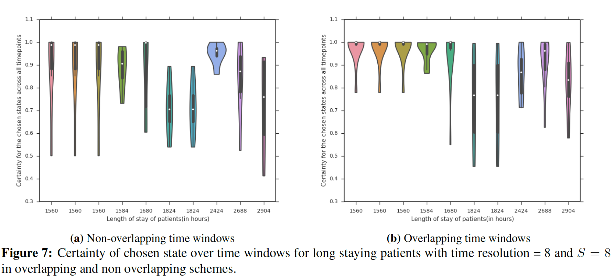
Design choices-Non/Overlapping time windows-continued

Slide 27
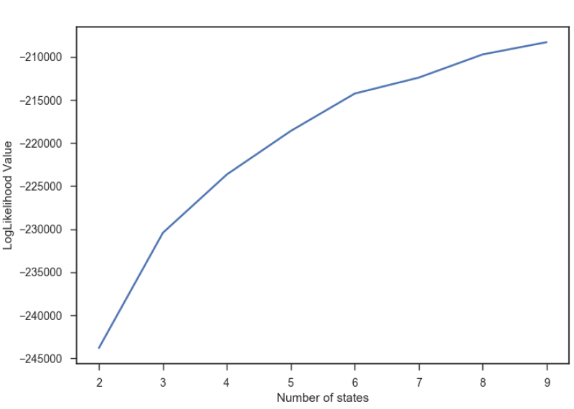
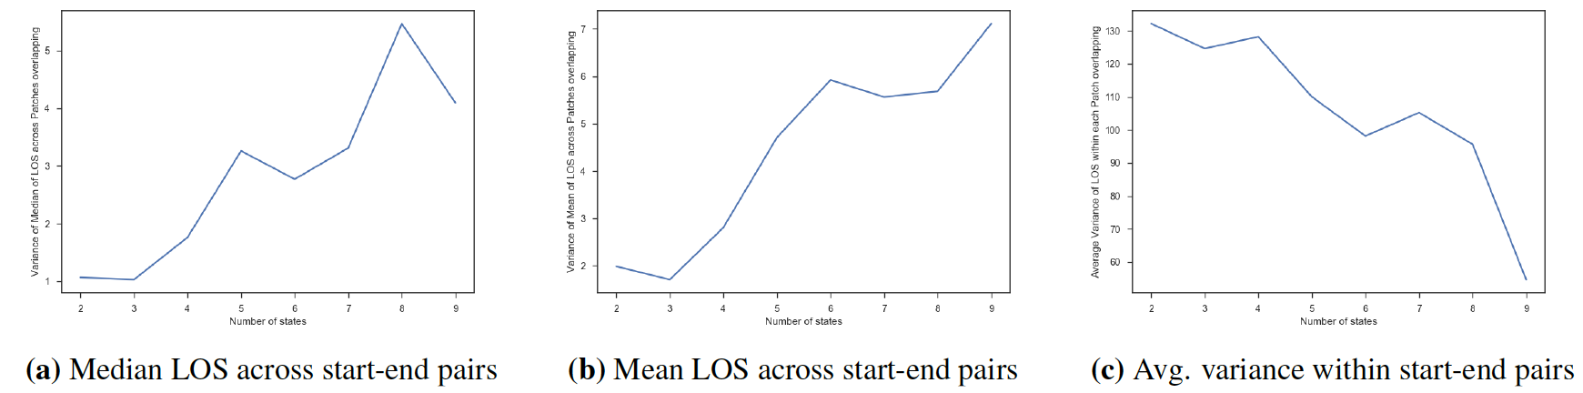
Optimum number of states
Number of states = 8
Number of states = 8
Number of states = 8
Number of states
Number of states
Likelihood Value
Number of states
Variance of Median LOS
Average variance of LOS
Notes:
first is homogeneity
Second is distinguishability
lower is better
Homogeneity of Patients belonging to one start-end pair

Slide 28
RMSE Comparison
Model Description | RMSE ( In hours)
Ridge Regression (7 flattened features) | 236.91
Poisson Regression (7 flattened features) | 235.26
Negative Binomial Regression (7 flattened features) | 235.01
RBF SVR (7 flattened features) | 236.97
Lasso Regression* (7 flattened features) | 234.19
HMM Method** ( 7 features) | 228.12
SAPS-II (14 features) | 225.05
Notes:
Saps II has 14 features, 7 additional features
Tried including all, seemed rather like modelling noise square was one, capturing time evolution,not a fair baseline , correlation discovery single hmm might not be the best choice, different rates of update, how to tie different states together
Compare lasso and HMM

Slide 29
Combining ICU Types
ICU Type | RMSE mean of difference w.r.t baseline
1 Coronary Care | -1.97
2 Cardiac Surgery | -9.39
3 Medical | -7.56
4 Surgical | -6.07
ALL | 6.58
Combined (1,2) (3,4) | (-9.48)(-9.96)
Combined (1,2,3) (4) | (-12.44) (-4.66)
Combined (1,2,4) (3) | (-1.7) (-7.45)
Notes:
Intuitively it makes sense to combine 1 and 2 and 3 and 4 for better performance and solve sparsity
Best baseline lasso ran a t test Ran a 100 runs , average RMSE of a given patient

Slide 30
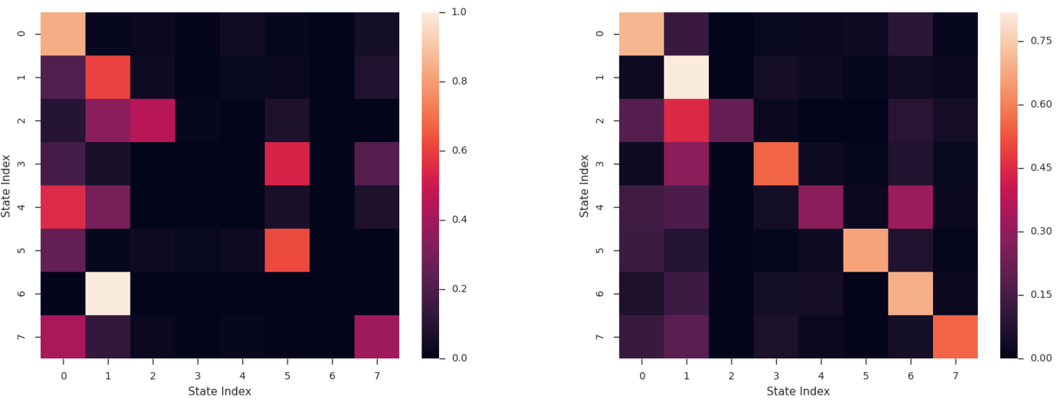
Interpretability
Next State
Next State
Most probable starting state
Trap state
Current state
S/ E |  | Not
7 | 6.43 | 4.85
6 | 9.6 | 6.07
Current state
Transition matrix ICU types 1 & 2
Transition matrix ICU types 3 & 4
Notes:
Between different states interpret
46000

Slide 31

Conclusion, Future Work
Lower RMSE, Better interpretability
Generalizability, Replication on MIMIC III dataset
More flexibility in #states for different populations
Auxiliary information for segmenting patients
Constraints in learning HMM parameters
Minimum probability in Transition matrix
Source
Notes:
7 feats vs 2000 not have assessd losing some predictability in the expense of explainability
Limitations,
: Lower number of samples
Replicating the same procedure on MIMIC II dataset
Enforcing Variability
(e.g., demographics, socioeconomic status)
Minimum probability in Transition matrix
Sufficient size for learning, realistic for practical purpose

